Slide 1







Developments In Technology And Analysis Presentation
George Michael
December 2020

Slide 2



OUTLINE
Executive Summary
Introduction
Methodology
Results
Visualization – Charts
Dashboard
Discussion
Findings & Implications
Conclusion
Appendix

Slide 3

EXECUTIVE SUMMARY
Trends in Technology
Currently used and desired;
Programming Languages
Databases
Platforms and Web frameworks
Demographics Survey
Gender gaps in Tech
Technology gaps in countries

Slide 4

INTRODUCTION
ABOUT: Tendencies in Tech Resources
OBJECTIVES:
Skill necessity for the future
Top programming languages in demand
Top database expertise in demand
Top platforms and IDEs in demand

Slide 5

METHODOLOGY
Data Collection Sources
Stack Overflow Developer 2019 Survey
Programming Language Annual Salary
GitHub Job Posting
Data Exploration
Data Cleaning
Data Visualization
Presentation

Slide 6
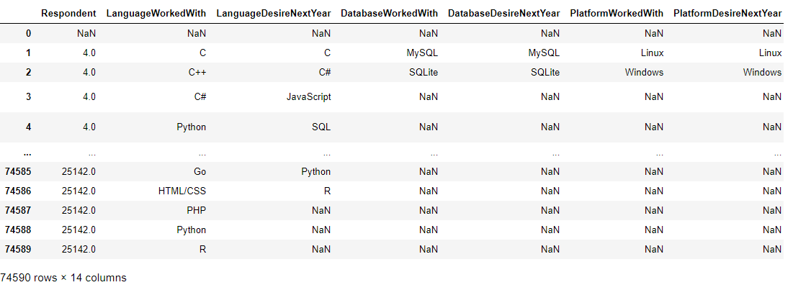
RESULTS
Results are based on this dataset

Slide 7
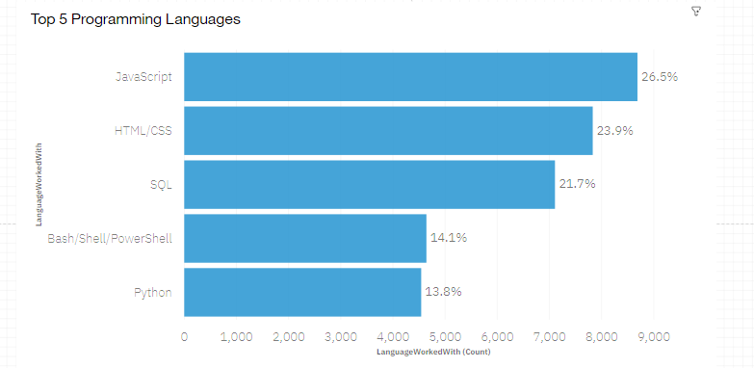
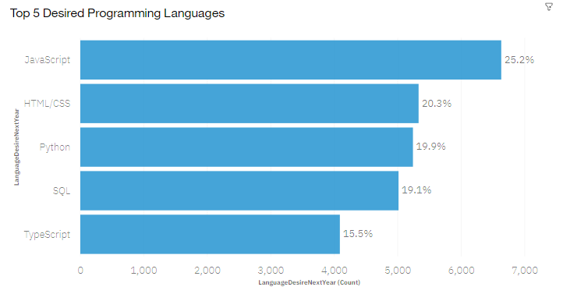
PROGRAMMING LANGUAGE TRENDS
Current Year
Next Year

Slide 8
PROGRAMMING LANGUAGE TRENDS - FINDINGS & IMPLICATIONS
Findings
JavaScript, HTML/CSS are top on both current and next year.
Python and TypeScript increases in upcoming year.
PowerShell got edged out in the next year
Implications
Web development still in high demand.
With Data Scientist’s in demand, Python remains best choice.
SQL remains the top database query language.

Slide 9
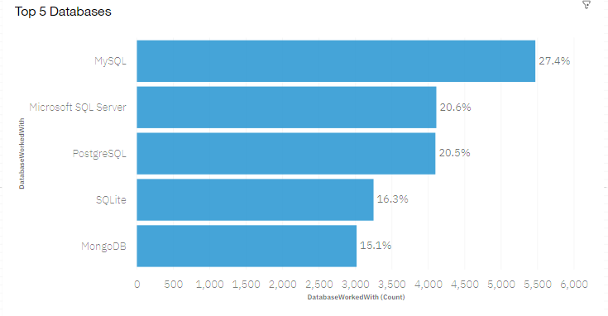
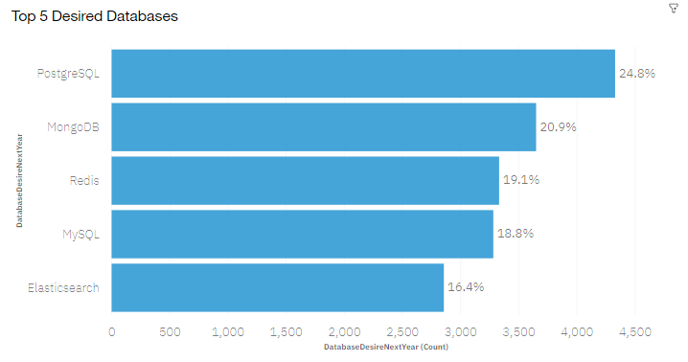
DATABASE TRENDS
Current Year
Next Year

Slide 10
DATABASE TRENDS - FINDINGS & IMPLICATIONS
Findings
High increase in MongoDB and Redis.
Microsoft SQL Server edged out of the Top 5.
MySQL remains very popular.
Implications
Increase in MongoDB means increase in Node.JS developers.
Major demand in databases used by backend developers.
Open-Source databases still preferred by companies.

Slide 11

DASHBOARD
IBM COGNOS DASHBOARD LINK
https://eu-gb.dataplatform.cloud.ibm.com/dashboards/8eeaf49e-009a-4bea-a0cb-2346131a7120/view/4514f13865a937890db4f6e407cf2c0e7431220cb3bbd50288d07b490a657597f03d11c3c82819098c150162a6be14599b

Slide 12
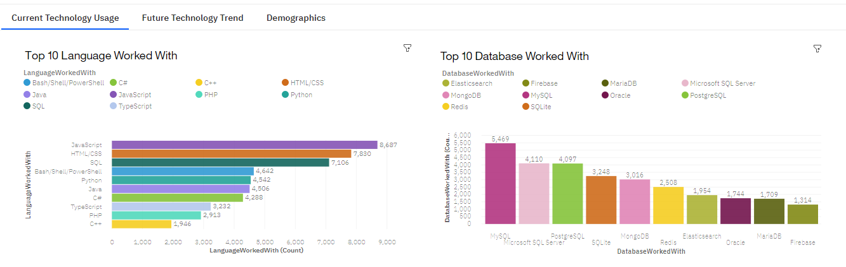
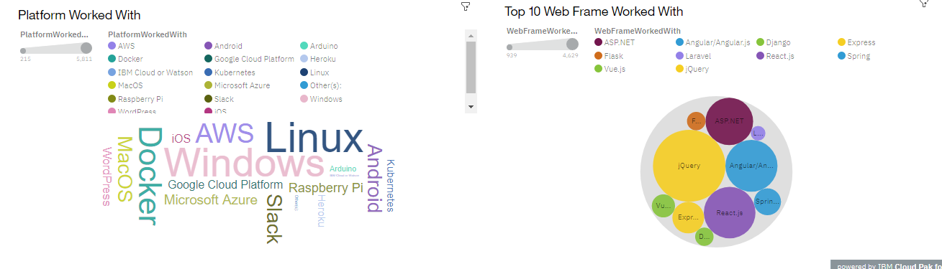
CURRENT TECHNOLOGY USAGE

Slide 13
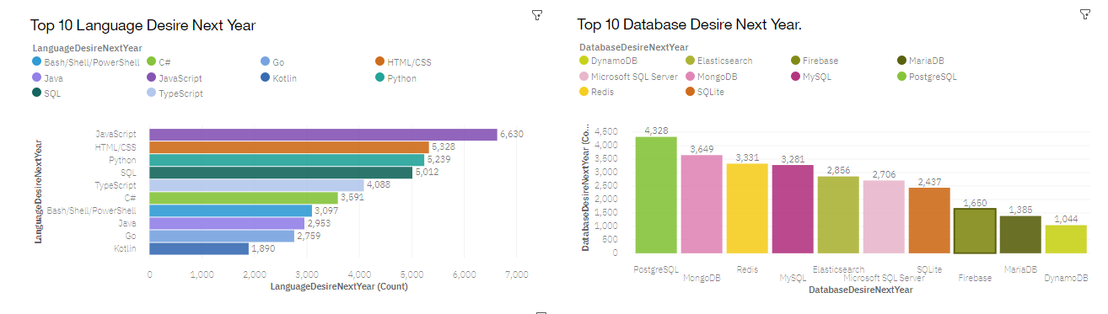
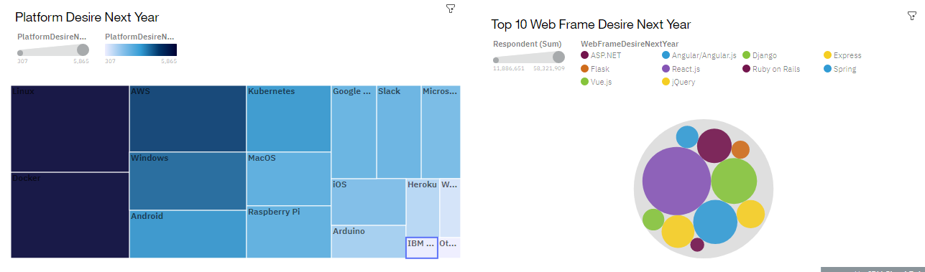
FUTURE TECHNOLOGY TRENDS

Slide 14
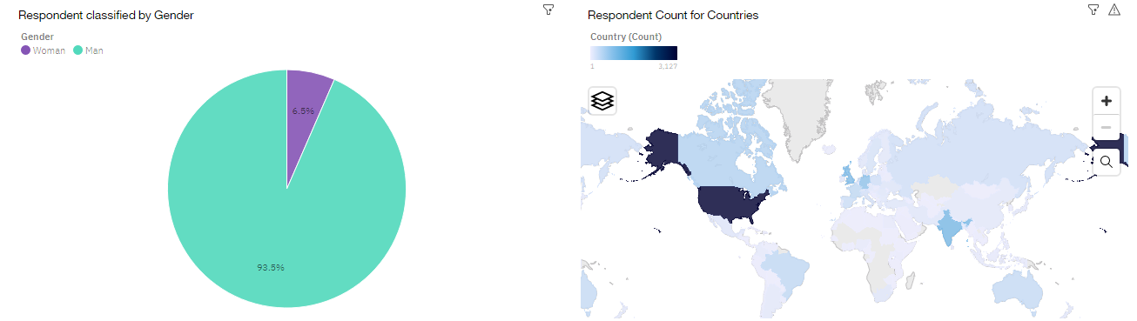
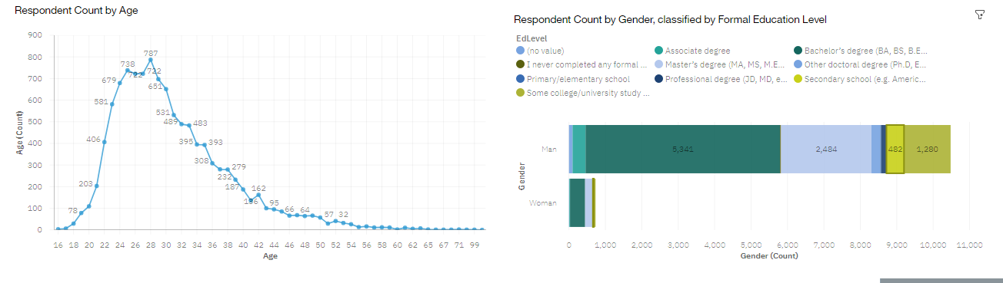
DEMOGRAPHICS

Slide 15
DISCUSSION
Technology trends now and future.
Female participation in tech fields.
Learning of new skills by developers.
Abolishing age and gender judgment in tech.
Overcoming technology gaps in developing countries.

Slide 16
OVERALL FINDINGS & IMPLICATIONS
Findings
Rapid upgrade in technology
Uneven gender amounts in technology
Concentration of new technology in USA.
Cloud platforms are rapidly growing in usage.
Implications
Companies need to adjust to the rapid advancement in technology.
Normalize gender equality in all technology roles.
Most developing countries need to change with the technological improvements.
The use of cloud services will massively increase a company’s output.

Slide 17

CONCLUSION
Technology trends now and in future
Programming languages, databases and platform overview
Demographics overview
Actions to be taken
Integrate Machine learning to predict salaries and technology trends

Slide 18
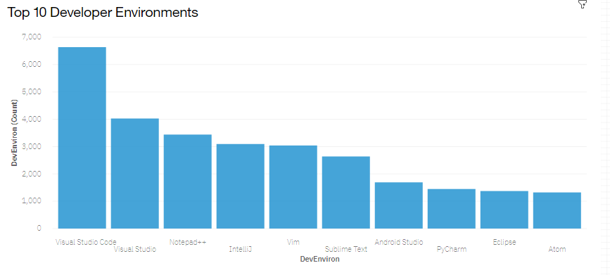

APPENDIX

Slide 19
GITHUB JOB POSTINGS

Slide 20
POPULAR LANGUAGES

